Slide 1
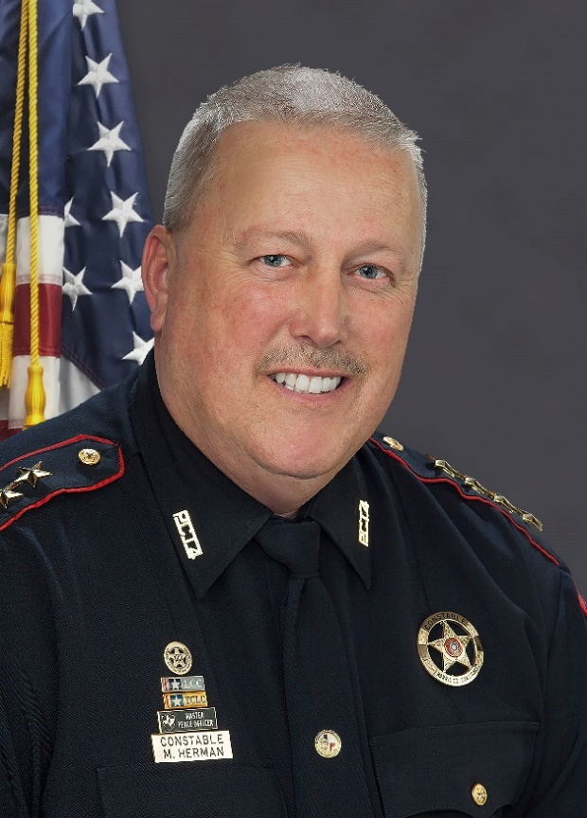
Harris County Precinct 4 Office of Constable Mark Herman
Honor Integrity Compassion Respect
www.facebook.com/Precinct4 www.constablepct4.com www.twitter.com/pct4constable www.pct4career.com

Slide 2
Our Mission Statement
The mission of the Constable's Office is to improve the quality of life for the citizens of Precinct 4 by working collaboratively with area law enforcement, commissioner's court, our community and our contract holders to prevent crime, enforce the law, increase mobility and target violent offenders for prosecution.
www.facebook.com/Precinct4 www.constablepct4.com www.twitter.com/pct4constable www.pct4career.com

Slide 3
Harris County Precinct 4 Constable’s Office
Largest Constable’s Office in the United States
Nearly 500 sworn deputies
Dozens of civilian support staff
Serves the citizens of Atascocita, Kingwood, Humble, Spring, Tomball, Klein, Jersey Village, Cypress and North Harris County
Multiple divisions and investigative units
Operates on a budget of over $52 million
Third largest law enforcement agency in Harris County behind HPD and HCSO
www.facebook.com/Precinct4 www.constablepct4.com www.twitter.com/pct4constable www.pct4career.com

Slide 4
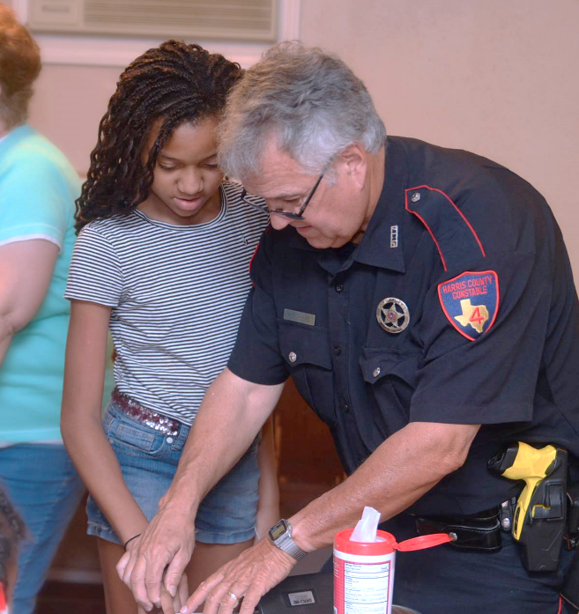
Harris County Precinct 4 Constable’s Office
We believe in community oriented policing.
www.facebook.com/Precinct4 www.constablepct4.com www.twitter.com/pct4constable www.pct4career.com

Slide 5
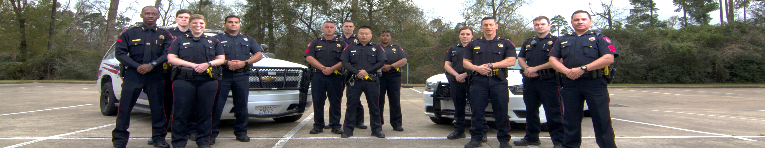
Precinct 4 Patrol Division
Largest division at Precinct 4
Operates out of six locations throughout the precinct
Practices high visibility patrol
Conducts vacation watch and extra patrol requests
Responds to all calls for service including but not limited to:
Illegal Dumping
Homicides
Sex Crimes
Child Abuse
Stalking and Harassment
Motor Vehicle Accidents
Suspicious Activity
Traffic Complaints
Robberies
Burglaries
Assaults
Criminal Mischief
Loud Noise
Disturbances
Alarms
Solicitors

Slide 6
Precinct 4 Parks Division
Patrols over 4,200 acres of county parks and greenways throughout north Harris County
Patrols in vehicles, on ATVs, on bicycles and on foot
Responds to calls-for-service at county parks and recreational facilities
www.facebook.com/Precinct4 www.constablepct4.com www.twitter.com/pct4constable www.pct4career.com

Slide 7
Precinct 4 K9 Unit
Narcotics Detection | Participates in local task forces
Criminal Apprehension | Participated in Super Bowl 51 Security
Bomb Detection | Conducts demonstrations for the public
www.facebook.com/Precinct4 www.constablepct4.com www.twitter.com/pct4constable www.pct4career.com

Slide 8
Precinct 4 Special Operations Unit
Created by Constable Herman in 2016 | Conducts high visibility traffic enforcement
Participates in local task forces | Conducts arrest and search warrants
Assists agency divisions and units | Combats serial part 1 street crimes such as burglaries, robberies and aggravated crimes
Conducts narcotics investigations
www.facebook.com/Precinct4 www.constablepct4.com www.twitter.com/pct4constable www.pct4career.com

Slide 9
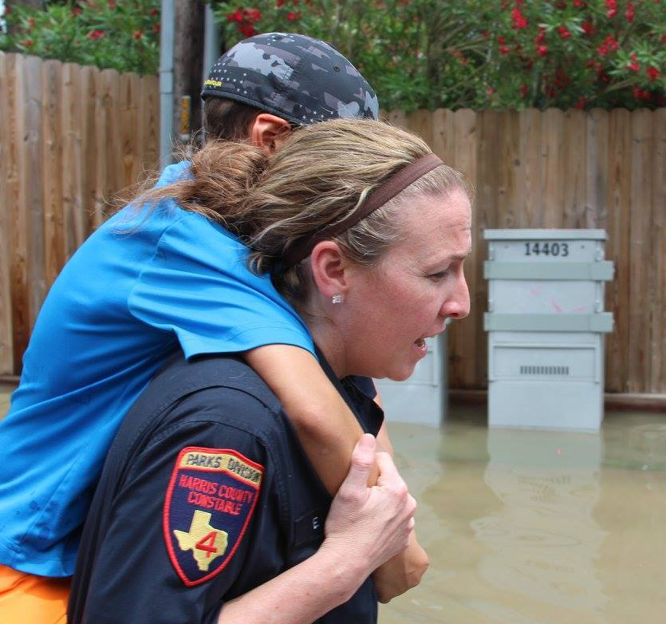
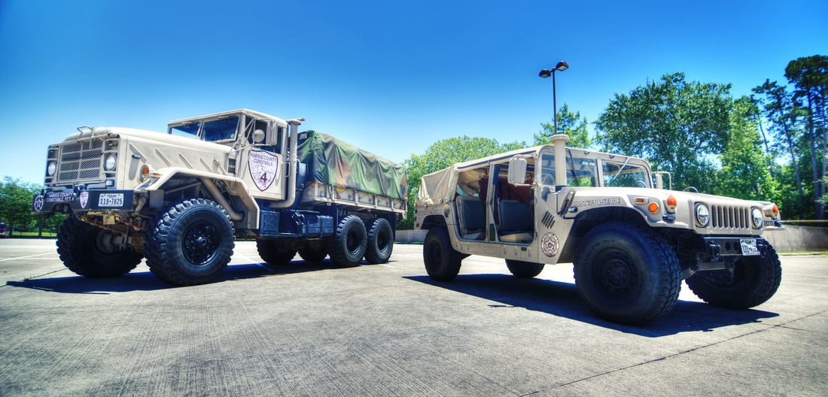
Precinct 4 High Water Rescue
Precinct 4 credited with over 100 water rescues during the April 2016 and Hurricane Harvey floods
Two 5-ton military transport vehicles | Deputies trained in swift-water rescue
One military style Humvee | Deployed during flooding and heavy rain
www.facebook.com/Precinct4 www.constablepct4.com www.twitter.com/pct4constable www.pct4career.com

Slide 10
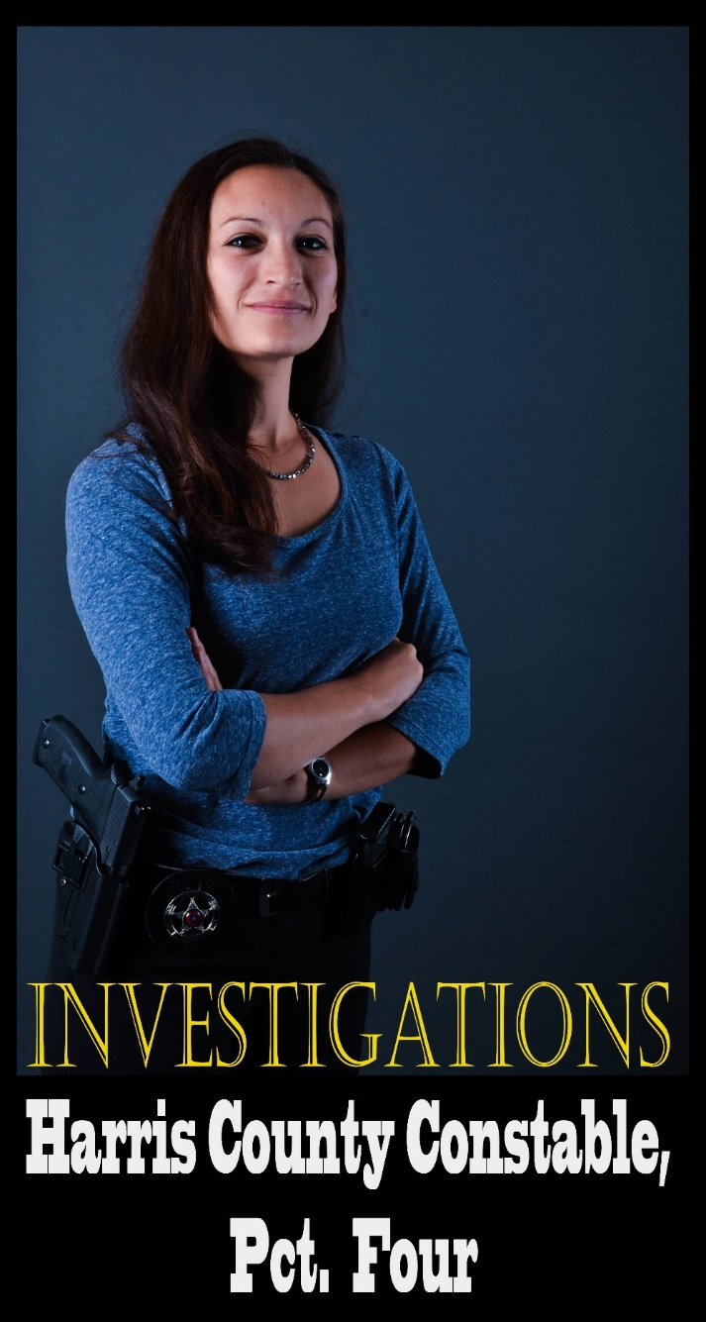
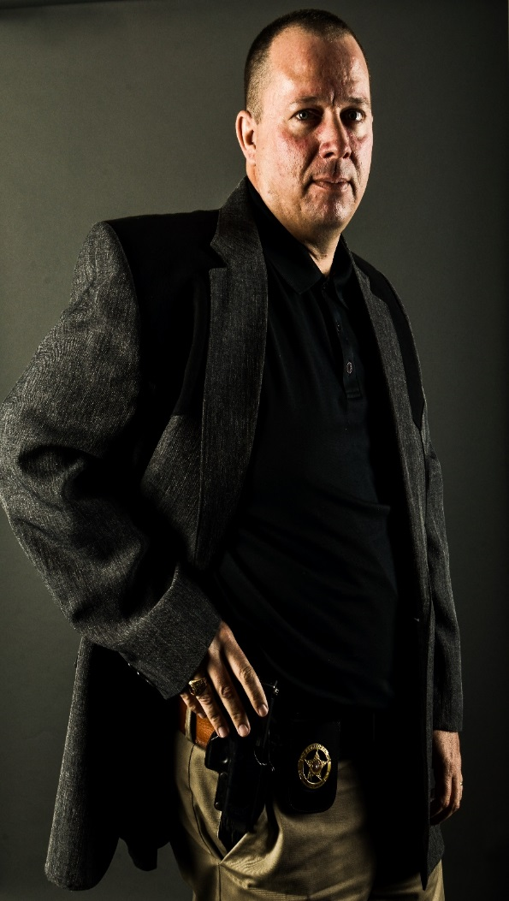
Precinct 4 Criminal Investigations Division
Division is made up of:
Regulatory Enforcement Unit
Human Trafficking Investigator
Family Violence Unit
Environmental Crimes Unit
High-Tech Crimes Unit
Special Contract Support Unit
CODIS Investigator
www.facebook.com/Precinct4 www.constablepct4.com www.twitter.com/pct4constable www.pct4career.com

Slide 11
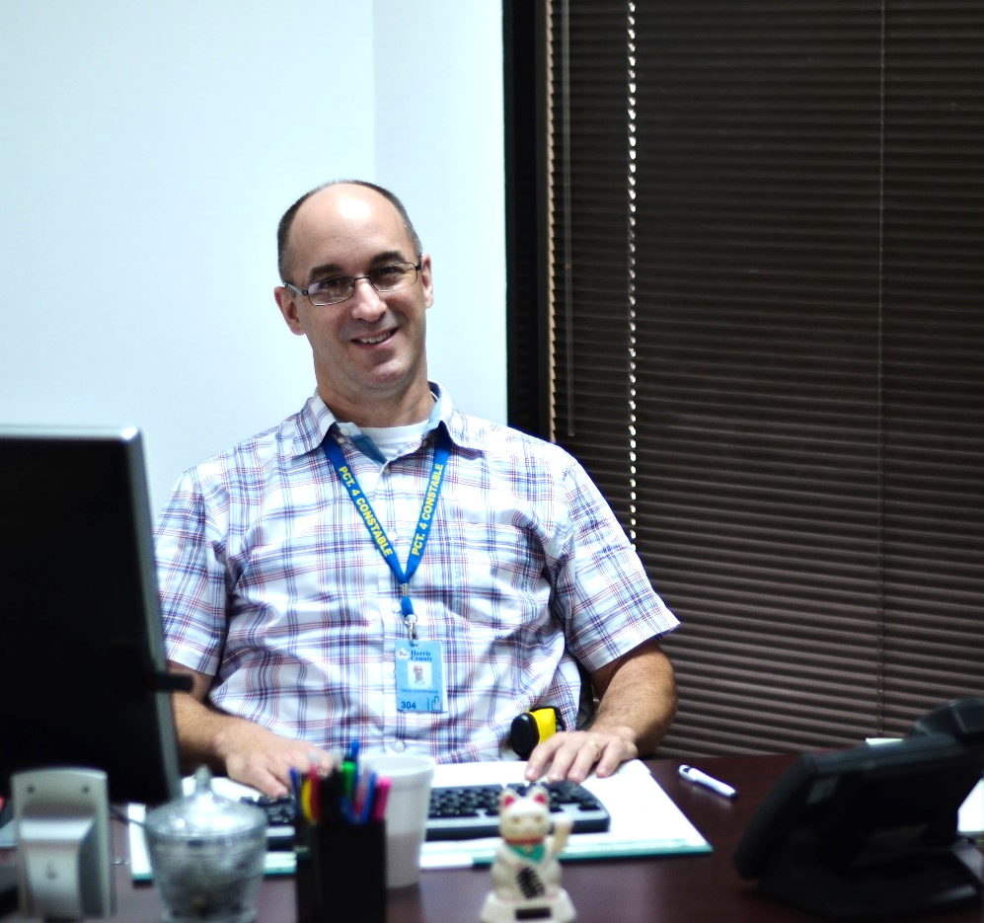
Precinct 4 Civil and Writs Division
Civil and writ process is one of the most important functions of a Constable’s Office
Serves legal documents originated by Harris County Justices of the Peace
Conducts auctions and sales of real property
Uses state of the art iPad applications to monitor and track service of civil process and papers
www.facebook.com/Precinct4 www.constablepct4.com www.twitter.com/pct4constable www.pct4career.com

Slide 12
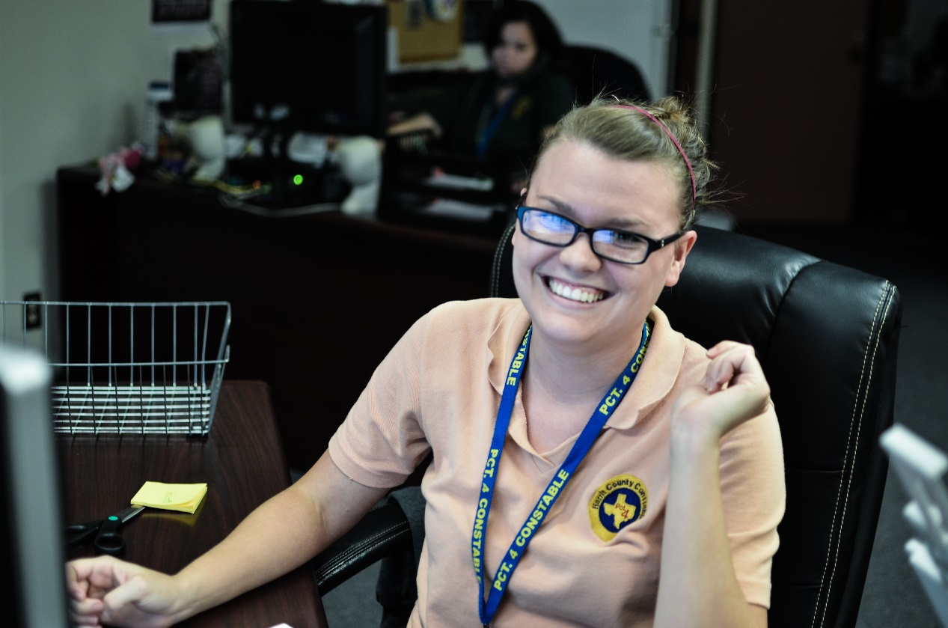
Precinct 4 Support and Administrative Assistance
Communications Division Records Division Human Resources Technical Services Crime Analysis Property and Evidence Room Internal Affairs Unit Field Training Unit Warrant Division
www.facebook.com/Precinct4 www.constablepct4.com www.twitter.com/pct4constable www.pct4career.com

Slide 13
State of the Constabulary
I am happy to report that the state of the Constabulary is good.
Precinct 4 has accomplished many things since Constable Mark Herman was appointed constable in May of 2015. Many of these accomplishments include:
Technological advances Equipment purchases Reallocation of resources to increase efficiency and productivity Contract growth | Creation of new divisions and units Process improvement Improved criminal enforcement Increased transparency and more
www.facebook.com/Precinct4 www.constablepct4.com www.twitter.com/pct4constable www.pct4career.com

Slide 14
The State of the Constabulary
The state of the Constabulary is good because we build partnerships…
www.facebook.com/Precinct4 www.constablepct4.com www.twitter.com/pct4constable www.pct4career.com

Slide 15
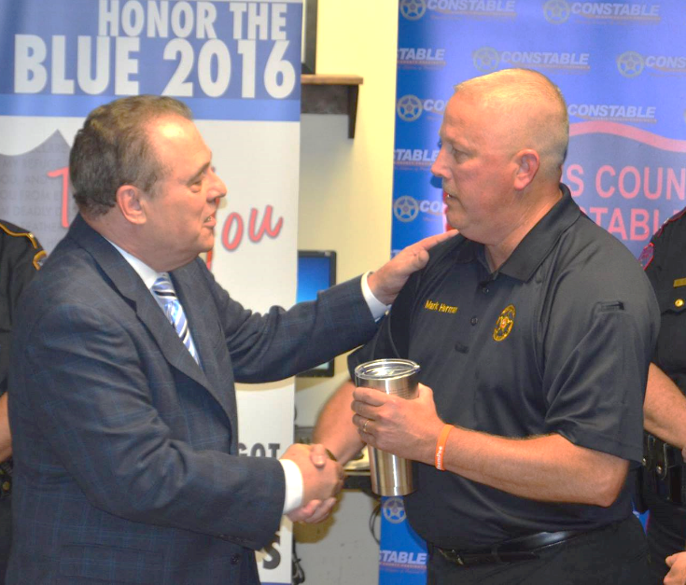
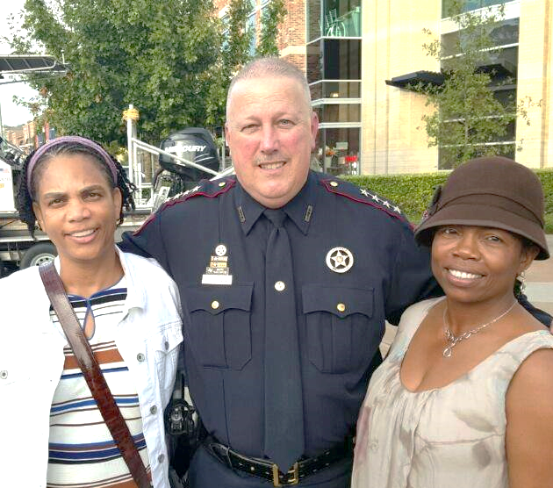
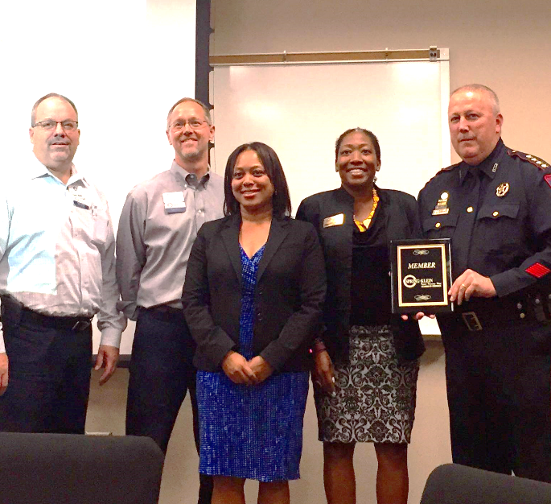
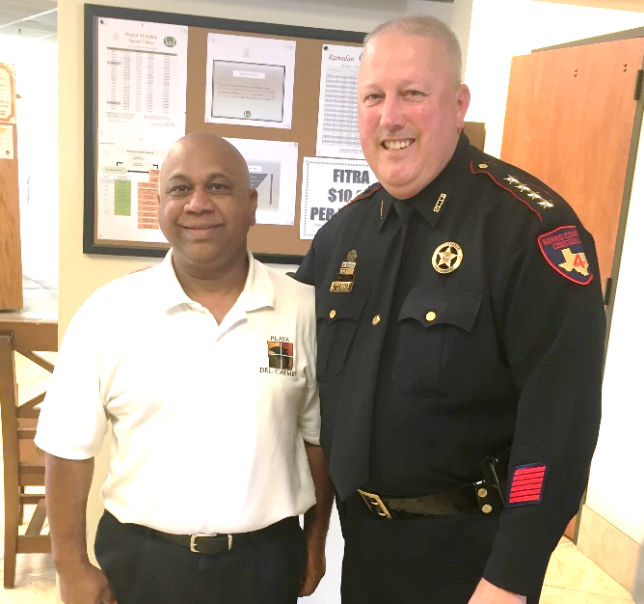
The State of the Constabulary
Partnerships with the community…
www.facebook.com/Precinct4 www.constablepct4.com www.twitter.com/pct4constable www.pct4career.com

Slide 16
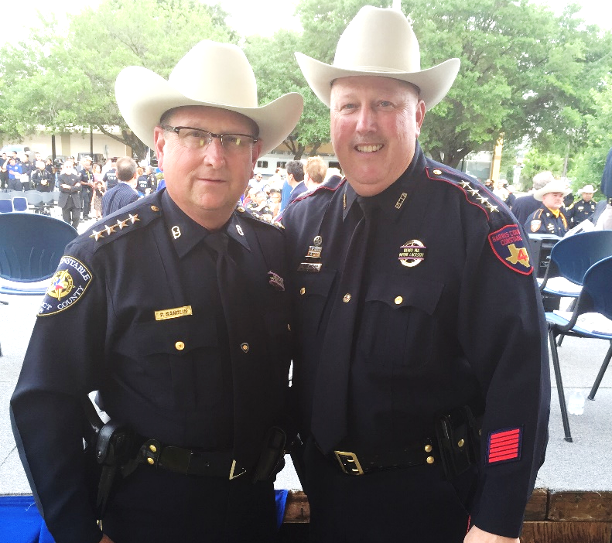
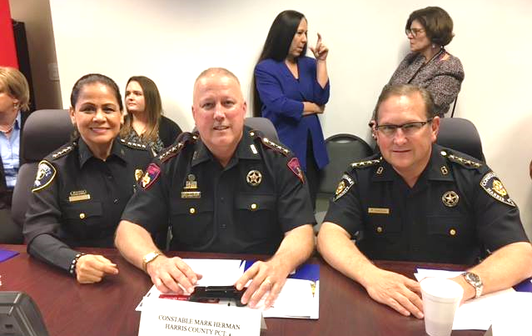
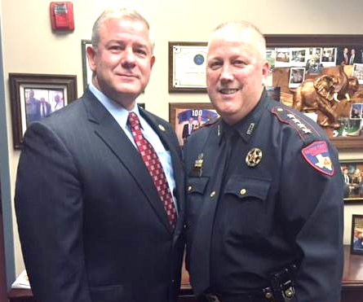
The State of the Constabulary
Partnerships with our local law enforcement…
www.facebook.com/Precinct4 www.constablepct4.com www.twitter.com/pct4constable www.pct4career.com

Slide 17
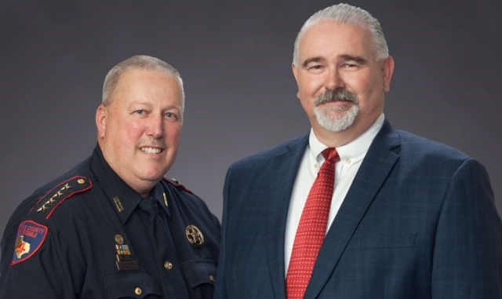
The State of the Constabulary
Partnerships with our Harris County Commissioners…
www.facebook.com/Precinct4 www.constablepct4.com www.twitter.com/pct4constable www.pct4career.com

Slide 18
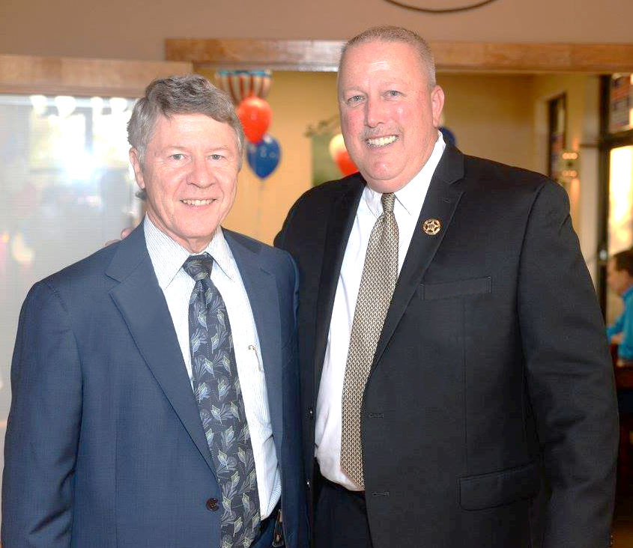
The State of the Constabulary
And partnerships with our Harris County Judge
www.facebook.com/Precinct4 www.constablepct4.com www.twitter.com/pct4constable www.pct4career.com

Slide 19
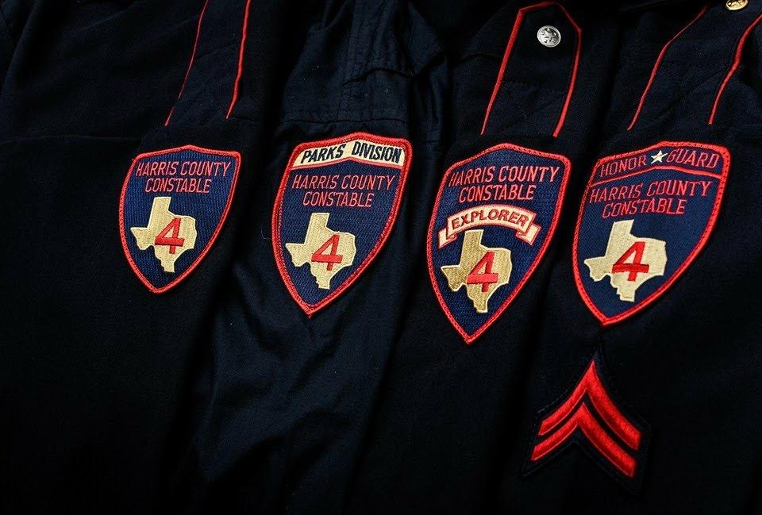
WORN PROUDLY
Visit us at: www.constablepct4.com
Like us on Facebook at: www.facebook.com/Precinct
Follow us on Twitter at: www.twitter.com/pct4constable

Slide 20
Thank you and have a great day!
www.facebook.com/Precinct4 www.constablepct4.com www.twitter.com/pct4constable www.pct4career.com

